Slide 1
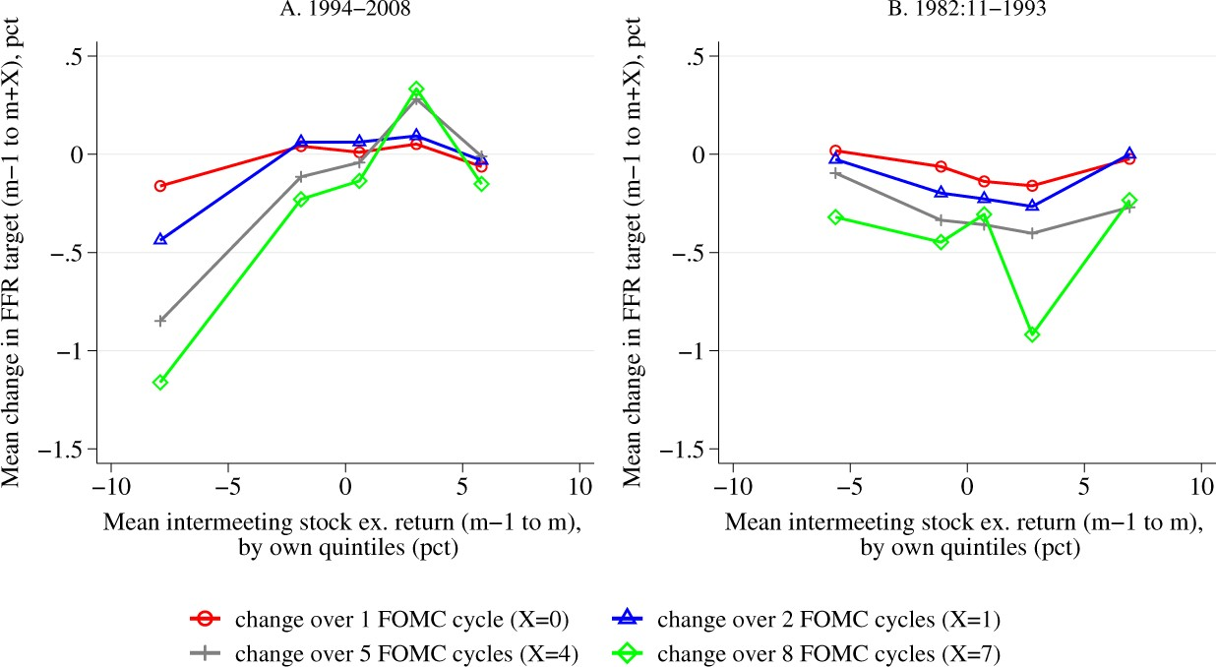

Figure 1 Changes in the FFR target conditional on the intermeeting stock excess returns The figure plots the average ...
Notes:
Figure 1 Changes in the FFR target conditional on the intermeeting stock excess returns The figure plots the average cumulative FFR target change from day 0 of cycle $m-1$ to day 0 of cycle $m+7$ (approximately a 1-year period) by quintiles of the intermeeting excess return, $rx_m$. The quintiles of intermeeting returns are constructed over the 1994–2008 sample.
Unless provided in the caption above, the following copyright applies to the content of this slide: © The Author(s) 2020. Published by Oxford University Press on behalf of The Society for Financial Studies. All rights reserved. For permissions, please e-mail: journals.permissions@oup.com.This article is published and distributed under the terms of the Oxford University Press, Standard Journals Publication Model (https://academic.oup.com/journals/pages/open_access/funder_policies/chorus/standard_publication_model)

